Slide 1
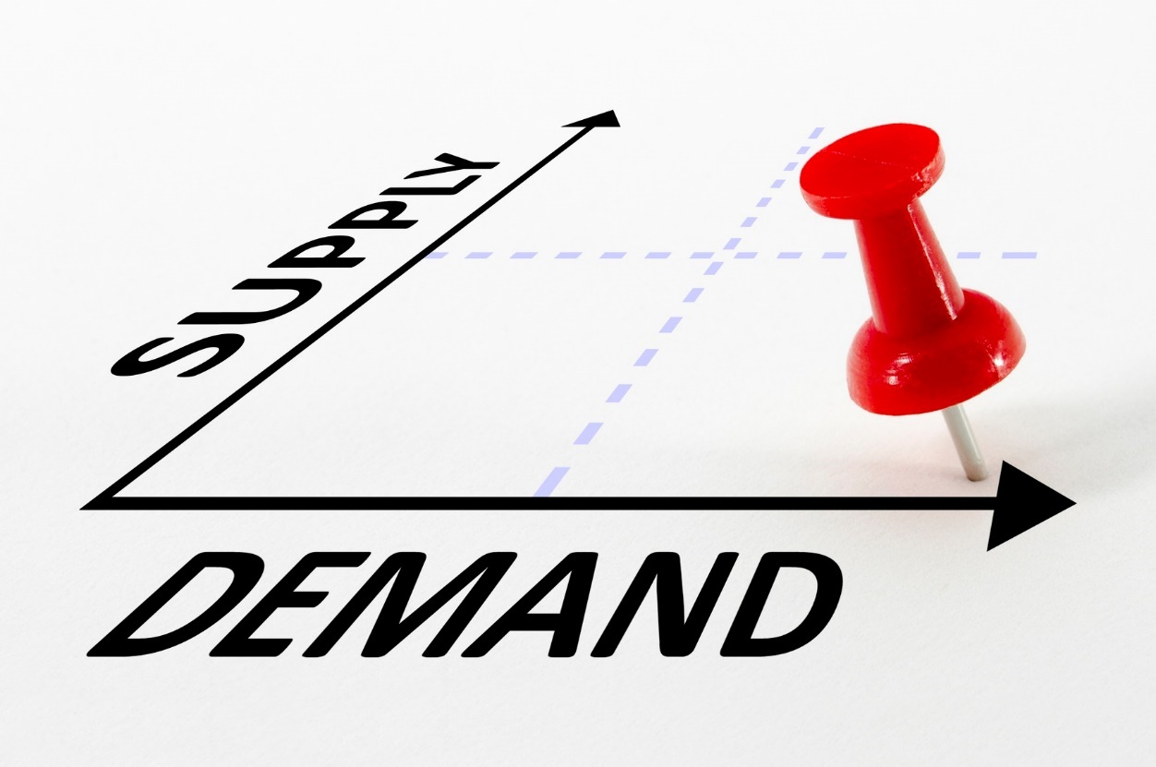
Theory of demand and supply
In economics and Management
Notes:
NOTE:
To change the image on this slide, select the picture and delete it. Then click the Pictures icon in the placeholder to insert your own image.

Slide 2
Presented by, Shah bhumi id: - 217beitg002 branch: - Information technology

Slide 3
Contents
Basic Concept And Definitions
Determinants Of Demand
Law of Demand
Determinants Of Supply
Law of Supply
Relation between Demand and Supply
Case Study

Slide 4
Basic Concept And Definitions
Basic Concept: Why Demand and Supply are used?
Concept of supply and demand is used to determine market price of goods or services(commodities).
Definitions
Demand : - Willingness and ability of consumer to buy a commodity at given price is known as ‘Demand’.
Supply : - The total amount of a specific good or service that is available to consumers is known as ‘Supply’.

Slide 5
Determinants Of Demand
Price
Income
Prices of related goods ( e.g. substitutes, complements)
Tastes
Expectations
Number of buyers

Slide 6
Law of Demand
The quantity demanded of a commodity falls when the price of the commodity rises.
Price and quantity demanded are negatively related.
In other words, “If the price of commodity increases, quantity demanded decreases and if the demand increases , price of commodity decreases.”
Price | Quantity demanded
100 | 5000
200 | 4000
300 | 3000
400 | 2000
500 | 1000

Slide 7
Law Of Demand (Cont…)
Price

Slide 8
Determinants Of Supply
Price
Input prices
Technology
Expectations
Number of sellers
Natural Calamities
Government Policies

Slide 9
Law of Supply
The quantity supplied of a good rises when the price of the good rises.
Quantity supplied is positively related to the price of the good.
In other words, “As the price of commodity increases , the supply of commodity increases.”
Price | Quantity demanded
100 | 1000
200 | 2000
300 | 3000
400 | 4000
500 | 5000

Slide 10
Law Of Supply (Cont…)
Price

Slide 11
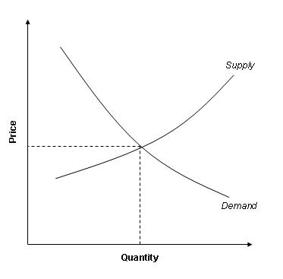
Relation between Demand and Supply
When, supply and demand curves intersect, At this equilibrium price quantity supplied equals quantity demanded.
Equilibrium is a situation in which supply equals demand.
Equilibrium price is also called as the market clearing price as quantity supplied equals quantity demanded.

Slide 12
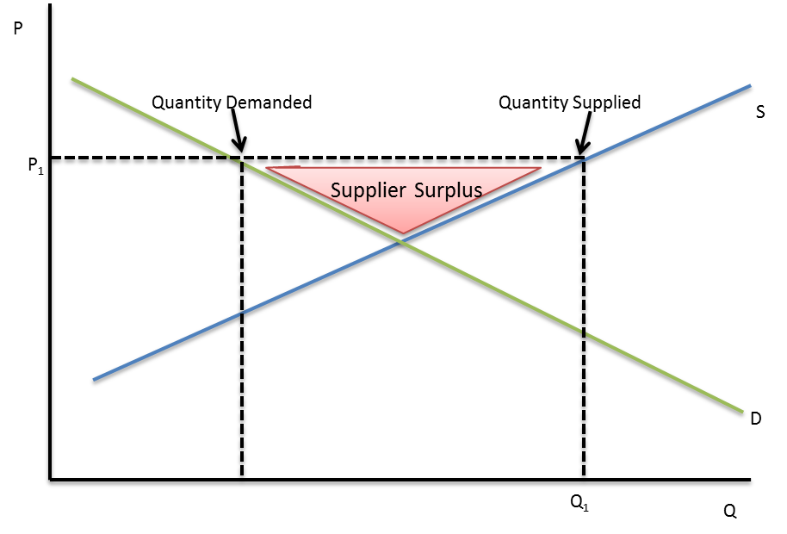
Relation between Demand and Supply (Cont…)
Two situations occur when market price is not equal to the equilibrium price.
Excess supply- surplus in the market
Excess demand- shortage in the market
Surplus situation : -

Slide 13
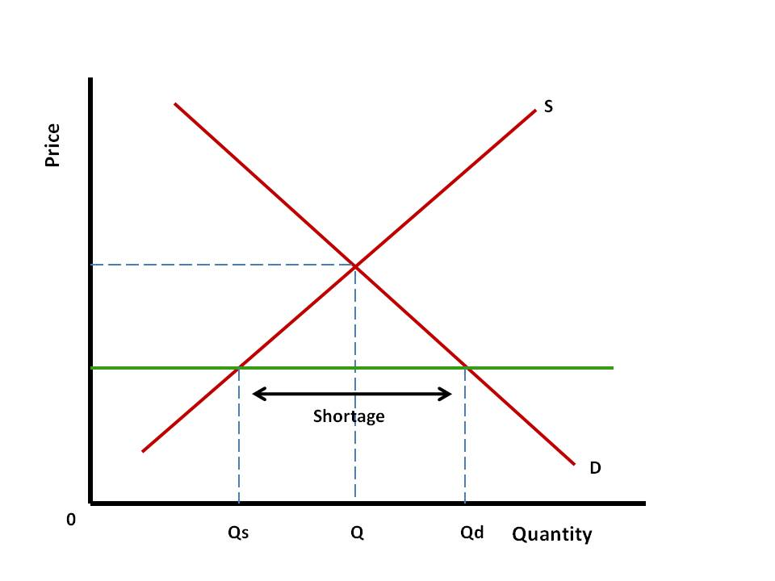
Relation between Demand and Supply (Cont…)
Shortage situation : -

Slide 14
Case Study : HP
About: -
HP stands for HEWLETT PACKARD.
HP is the largest Laptop & PC production company in the world (21.8%).
It highest market share in India (29.5%).
Main Headquarters – CALIFORNIA (USA).
Corporate Office – BANGALORE.
Demand and Supply Analysis : -
According to current market share , demand for HP laptops increasing day by day.
Due to pavilion and notebook series demand for laptops has been increased.

Slide 15

Case Study (Cont…)

Slide 16
Thank You

